Slide 1

Tripmates
JuiCy buNS
Janice Lee
Cynthia Zhou
Nancy Luong
Sophia Kwon

Slide 2





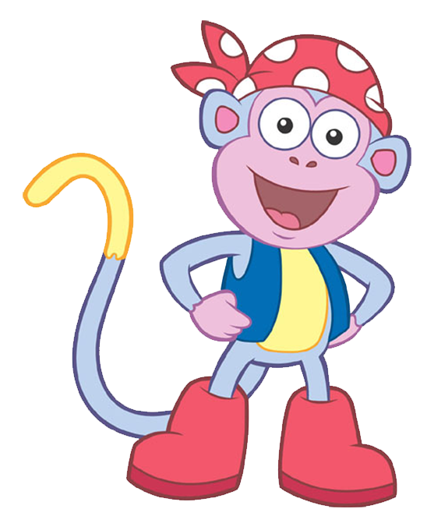
Purpose
Notes:
Most of you have probably gone on a vacation before with friends or family. And you’ve probably experienced the struggles of trying to plan a trip. Everyone on the trip has different sites they want to see, different activities they want to do, different restaurants they want to eat at. How do we plan everything out?

Slide 3
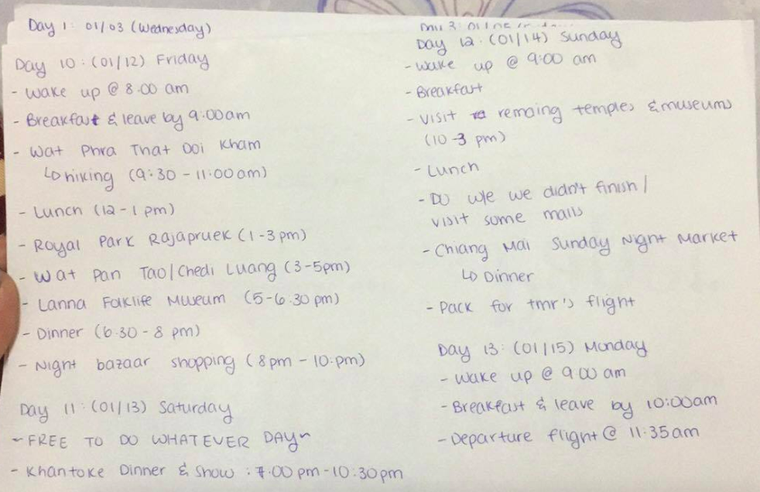
Notes:
Maybe your group will try meeting in person and mapping everything out on paper. But this is very tedious and inefficient.

Slide 4
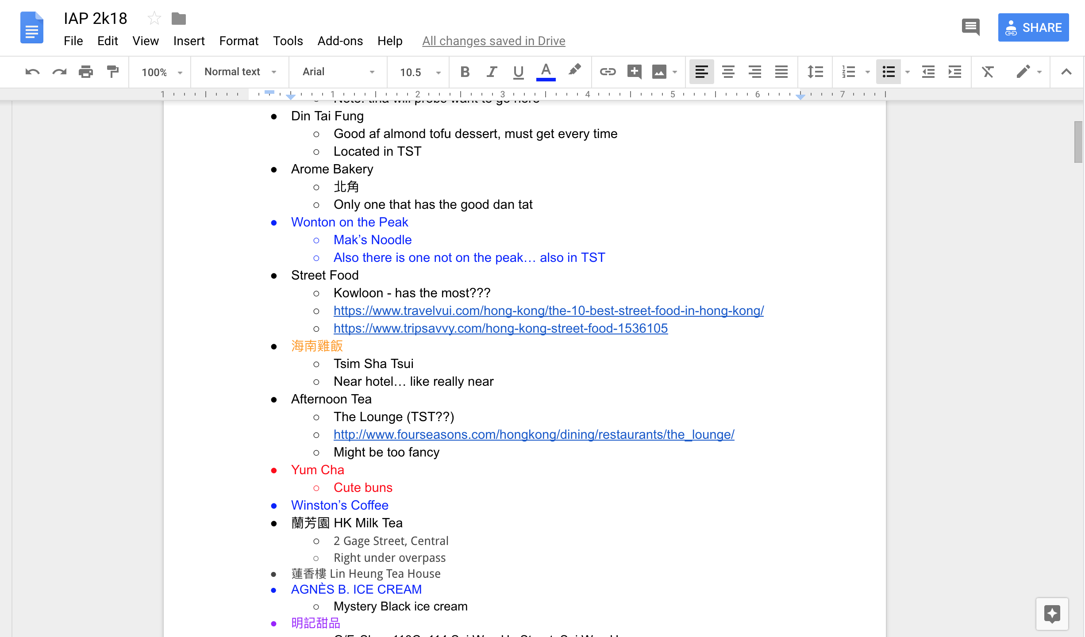
Notes:
Or maybe everyone will list their interests on Google Docs. But this is ugly and disorganized. It’s difficult to figure out everyone’s interests and create a schedule. Well we have a solution for you, and that’s Tripmates! Tripmates makes it easy to plan a trip between multiple people by providing a collaborative way to list everyone’s interests and efficiently create a schedule.

Slide 5
Concept
trip
Notes:
a trip (going somewhere with friends!):
-name
-date range
-users (all your friends)
-ideas (activities)

Slide 6



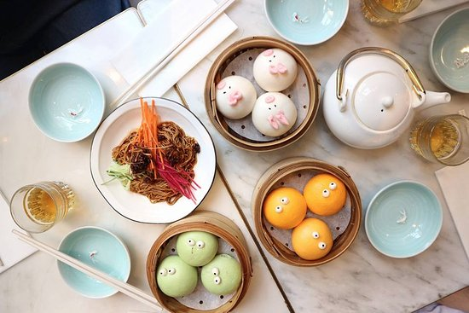
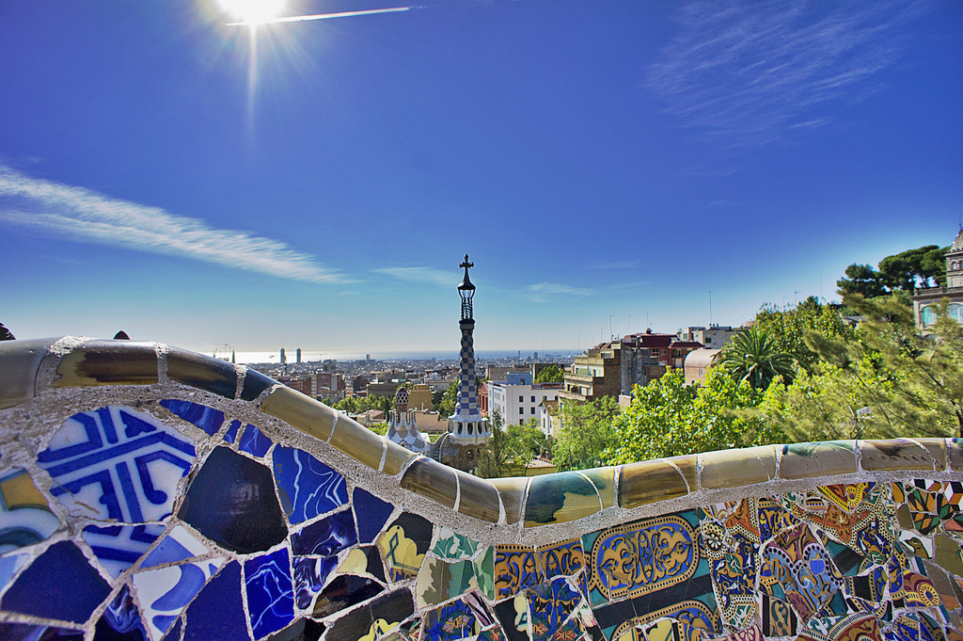
Concept
trip
activities
Notes:
ideas consist of activities (what people are interested in doing)
activities:
-name
-category (like shopping, eating)
-suggested duration
-place (hours and location)

Slide 7

Concept
trip
activities
itinerary
Notes:
itinerary (what you actually wanna do and when)
-events
wat are events?

Slide 8

Concept
trip
activities
itinerary
events
Notes:
events:
-activity (originating from your ideas)
-date/time range (Tues at 8-10pm)

Slide 9
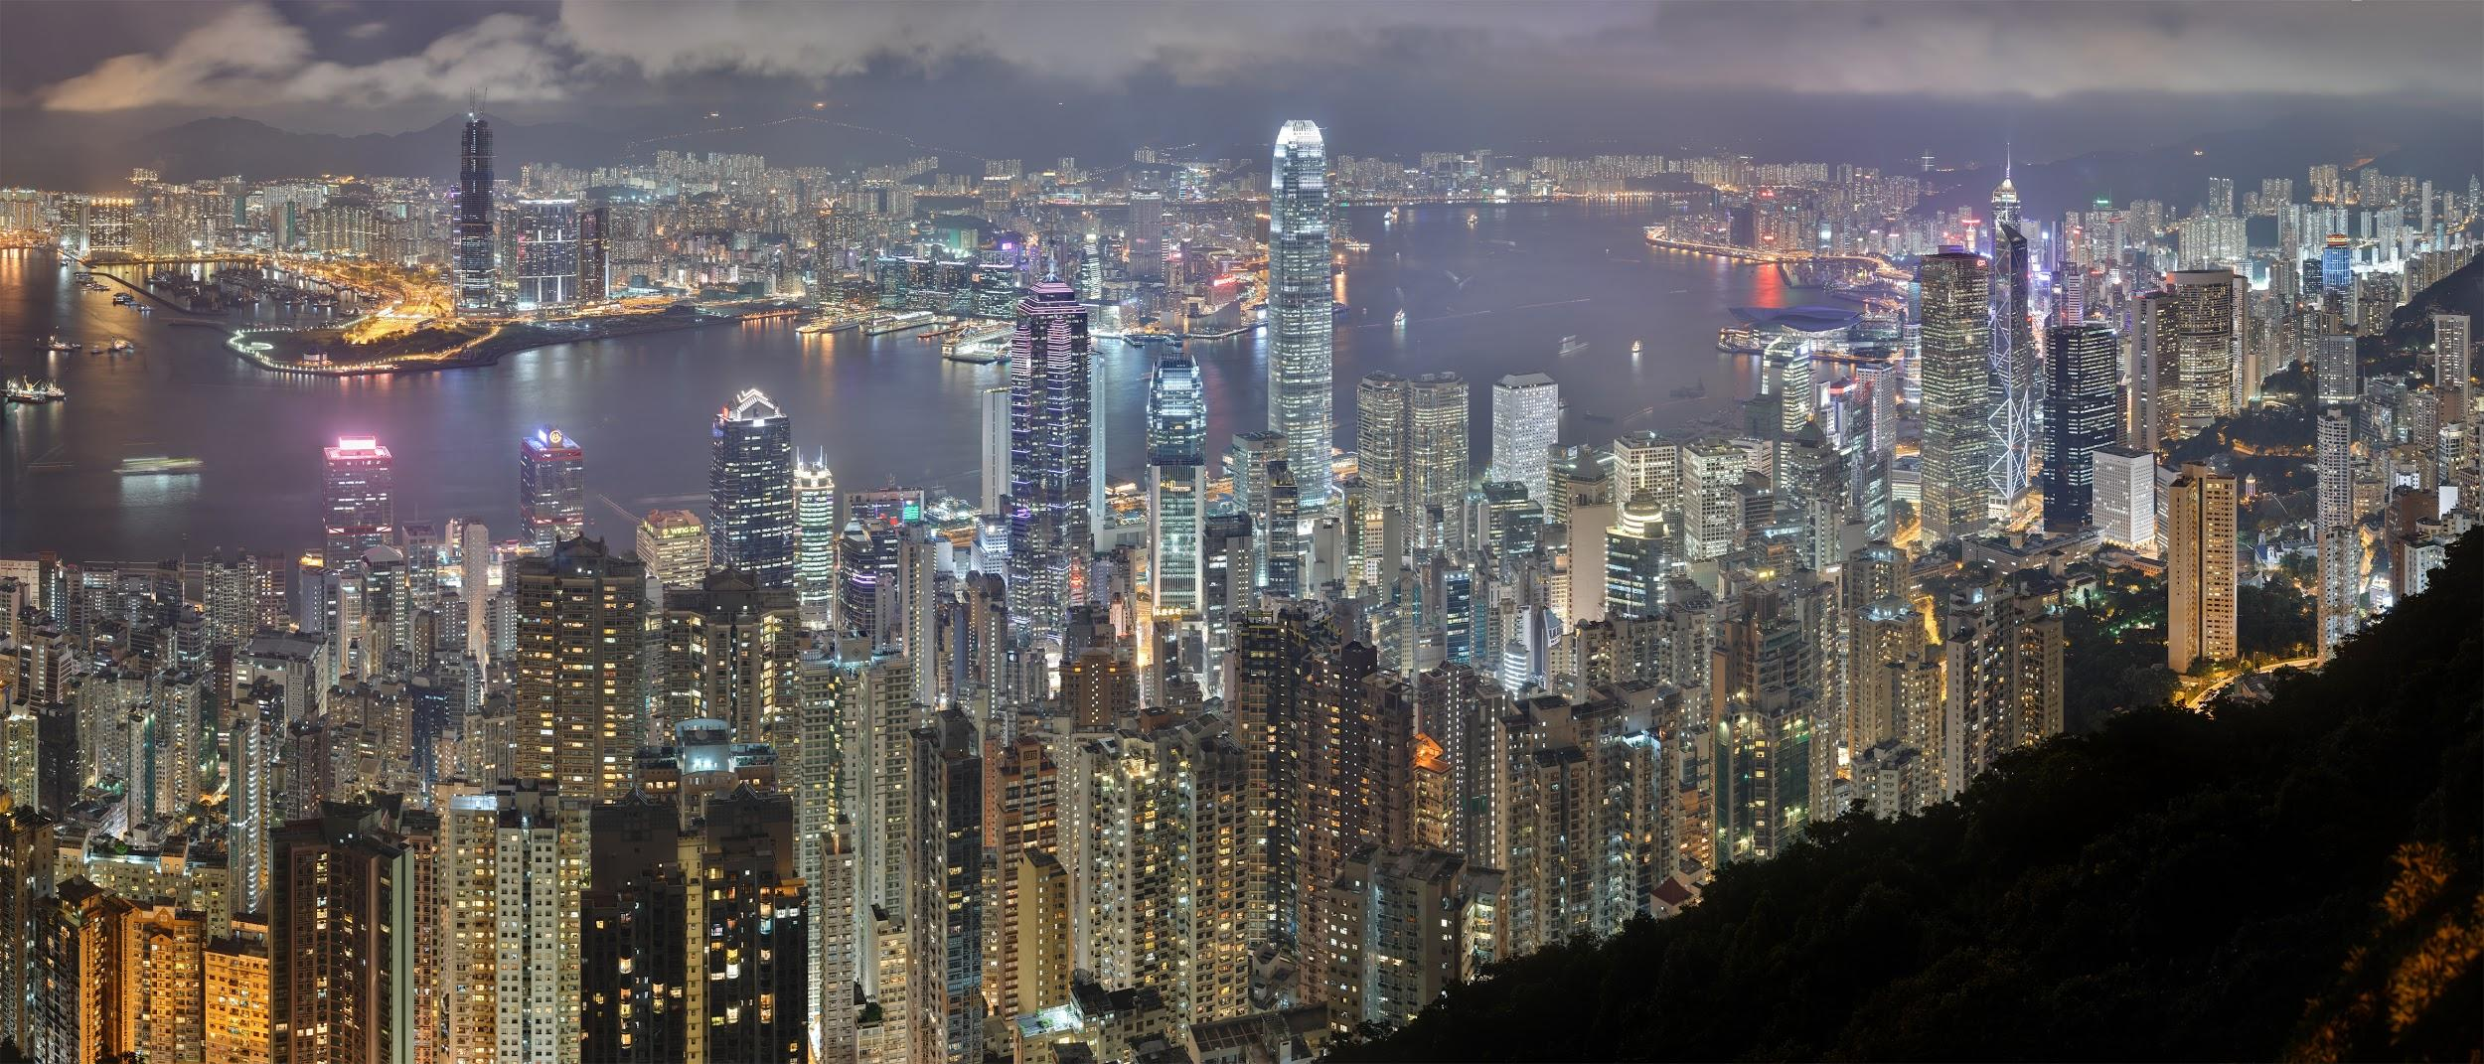
Notes:
Now, let’s take a look at some of the things you can do with Tripmates.
Say, you and a couple of friends decide to go to Hong Kong during IAP.
dora wants to go to Hong Kong during IAP

Slide 10
Trip
Get Wild & Funky @ HK
Jan 10 - Jan 21
Notes:
One of you can create a trip: just specify a name for the trip and a range of dates.
OP: create a trip with:
-name
-date range

Slide 11
Trip
Get Wild & Funky @ HK
Jan 10 - Jan 21
Notes:
Then, you can invite your friends to join and help plan the trip. Everyone will be able to edit the details of this trip.
OP: invite friends to join and help plan the trip

Slide 12

Trip
Get Wild & Funky @ HK
Jan 10 - Jan 21
Activities
Dim Sum
Category: Food
Location: HK Dim Sum
Hours: 9am-10pm
Duration: 3 hours
Notes:
Now, you can add activities that you’re interested in. Just specify the name of the activity.
You can also add other helpful details such as a place, suggested duration or type of activity for others to see as well.
OP: create activities for trip
-name
(optionals)
-suggested duration
-place (opening hours, location)
-category

Slide 13
Trip
Get Wild & Funky @ HK
Jan 10 - Jan 21
Activities
Gambling in Macau
Category: Make $$
Location: Macau Casino
Hours: 5pm-5am
Duration: 4 hours
Dim Sum
Category: Food
Location: HK Dim Sum
Hours: 9am-10pm
Duration: 3 hours
Notes:
Multiple users can collaborate on the same trip by adding to the list of activities.

Slide 14
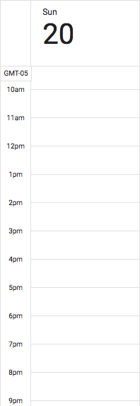
Trip
Itinerary
Get Wild & Funky @ HK
Jan 10 - Jan 21
Activities
Gambling in Macau
Category: Make $$
Location: Macau Casino
Hours: 5pm-5am
Duration: 4 hours
Dim Sum
Category: Food
Location: HK Dim Sum
Hours: 9am-10pm
Duration: 3 hours

Slide 15
Trip
Itinerary
Get Wild & Funky @ HK
Jan 10 - Jan 21
Dim Sum
Category: Food
Location: HK Dim Sum
Hours: 9am-10pm
Duration: 3 hours
Activities
Events
Gambling in Macau
Category: Make $$
Location: Macau Casino
Hours: 5pm-5am
Duration: 4 hours
Dim Sum
Category: Food
Location: HK Dim Sum
Hours: 9am-10pm
Duration: 3 hours
Gambling in Macau
Category: Make $$
Location: Macau Casino
Hours: 5pm-5am
Duration: 4 hours

Slide 16
Trip
Itinerary
Get Wild & Funky @ HK
Jan 10 - Jan 21
Activities
Events
Gambling in Macau
Category: Make $$
Location: Macau Casino
Hours: 5pm-5am
Duration: 4 hours
Dim Sum
Category: Food
Location: HK Dim Sum
Hours: 9am-10pm
Duration: 3 hours
Dim Sum
Category: Food
Location: HK Dim Sum
Hours: 9am-10pm
Duration: 3 hours
Gambling in Macau
Category: Make $$
Location: Macau Casino
Hours: 5pm-5am
Duration: 4 hours

Slide 17

Vámonos!

